Slide 1
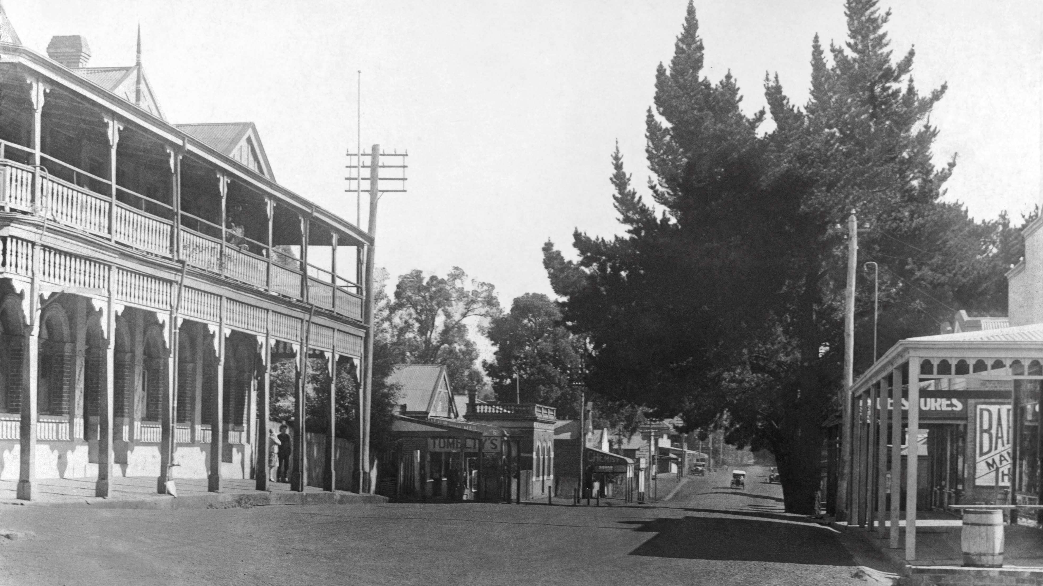
Heritage Tourism in Bridgetown
A tourism destination since 1905
BHS 95-426 c.1930 – tree removed 1932/3

Slide 2
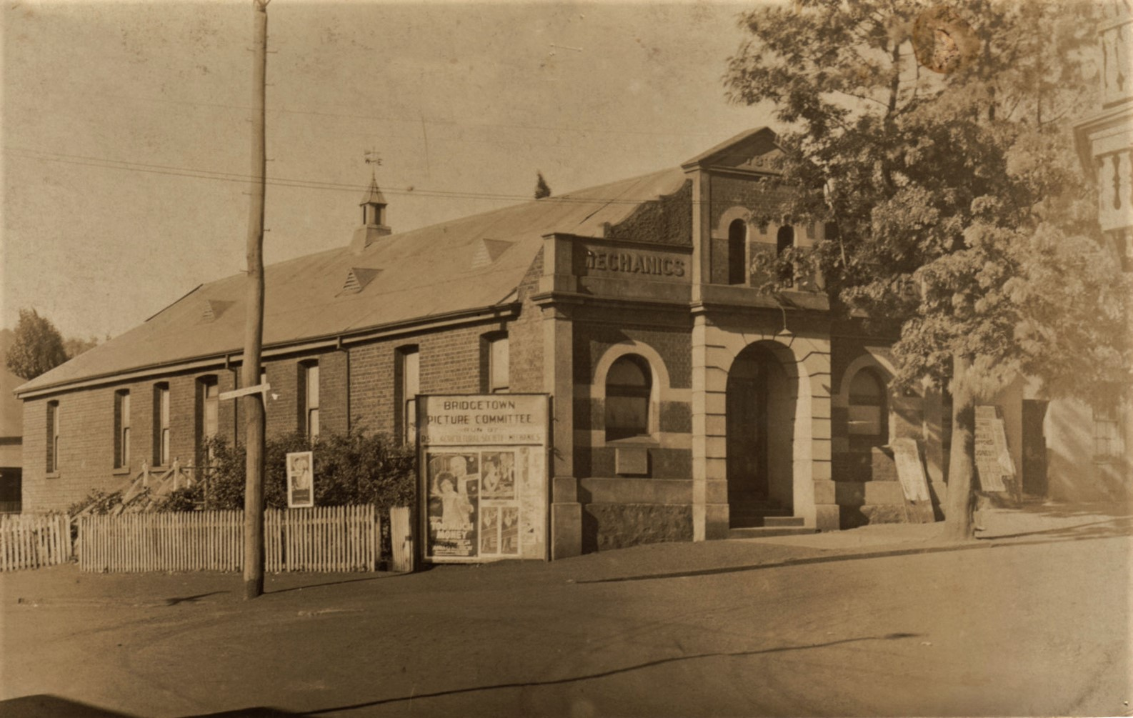
Tourism and Bridgetown
As early as 1905 the beauty of Bridgetown and its potential as a health resort was explored by local businesses, who formed a Visitors Association.
‘…this quaint old town … shady spots by the river, beautiful walks and drives among the hills and orchards, bathing places for both sexes in the Blackwood River … for mental relaxation … a well-conducted Mechanics' Institute … four good hotels … [and] ideal spots on the riverbank to locate a tent …
500 posters were produced to be distributed throughout WA.
Mechanics’ Institute built 1878
Ref: BHS 95-419

Slide 3
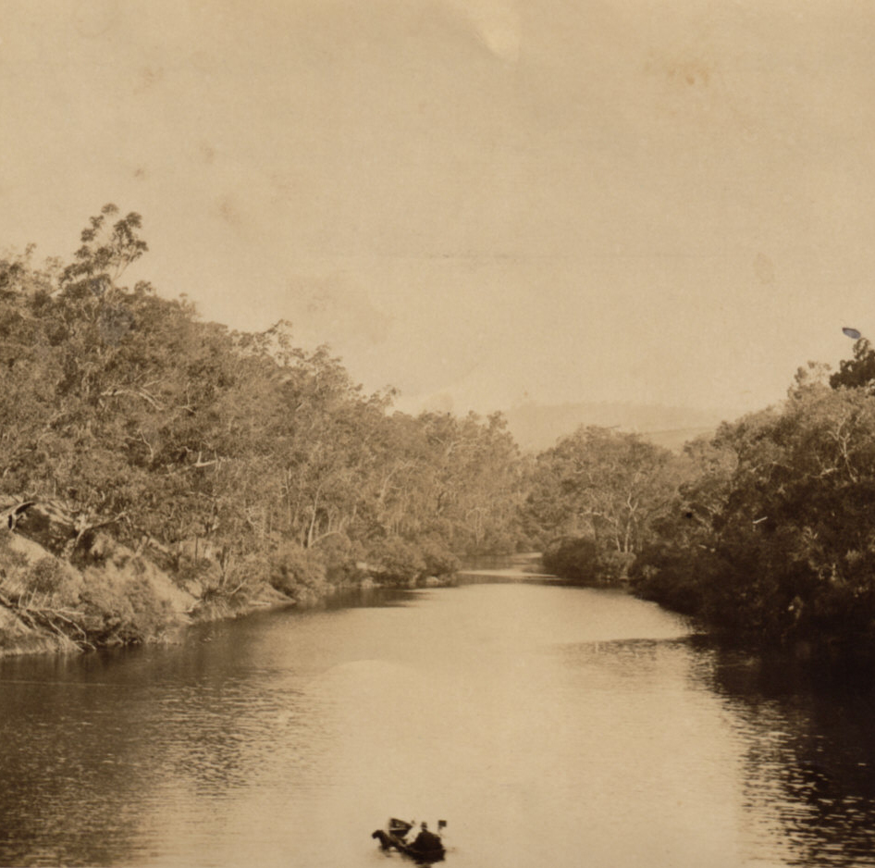
Tourism and Bridgetown
Ref: BHS 95-350 c.1900
In 1913, Bridgetown Traders’ Association raised 7 important points to increase tourists:
Advertise throughout WA; compile a booklet with views of Bridgetown and accommodation options; open up the tennis club to visitors; form a bowling club; resuscitate the band; a picture show to visit weekly; and offer car hire.

Slide 4
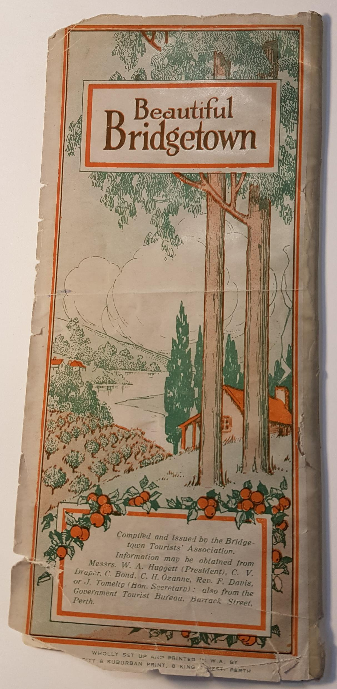
Tourism and Bridgetown
By 1924, tourists were actively targeted with this brochure to visit Bridgetown, compiled by the Bridgetown Tourists' Association.
Today the Shire uses this slogan!
Ref: SLWA_994.12BRI. c.1924

Slide 5
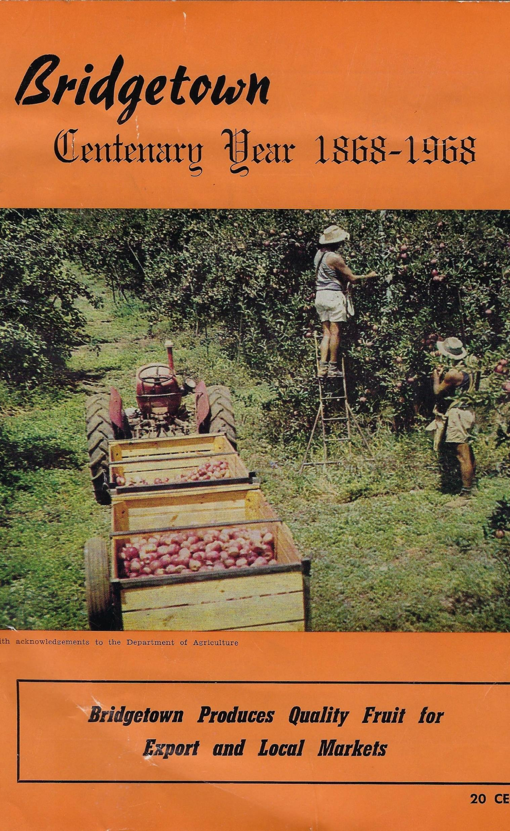
Tourism and Bridgetown
Through the 40s, 50s, and 60s Bridgetown relied on the rural industries (grazing, orcharding, dairying) for income.
Little thought was given to tourism.
But by 1970, the farmers and graziers were leaving in droves as prices plummeted and Bridgetown floundered.

Slide 6
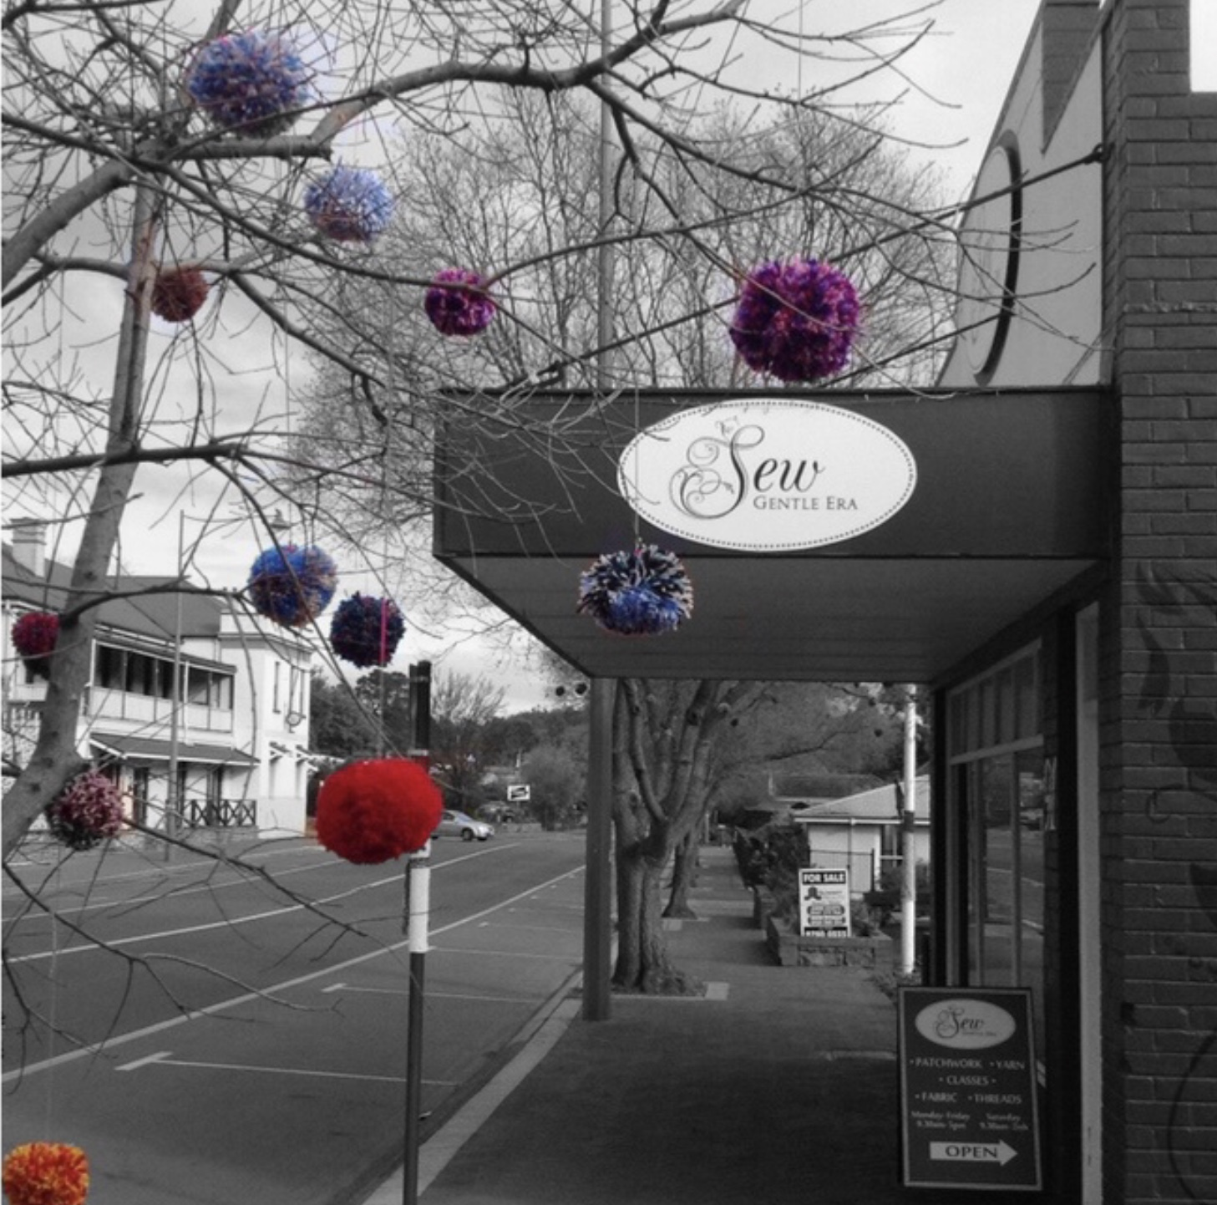
Tourism and Bridgetown
By the 80s it was clear much had to be done to bring tourists back to Bridgetown.
Innovation was the key

Slide 7
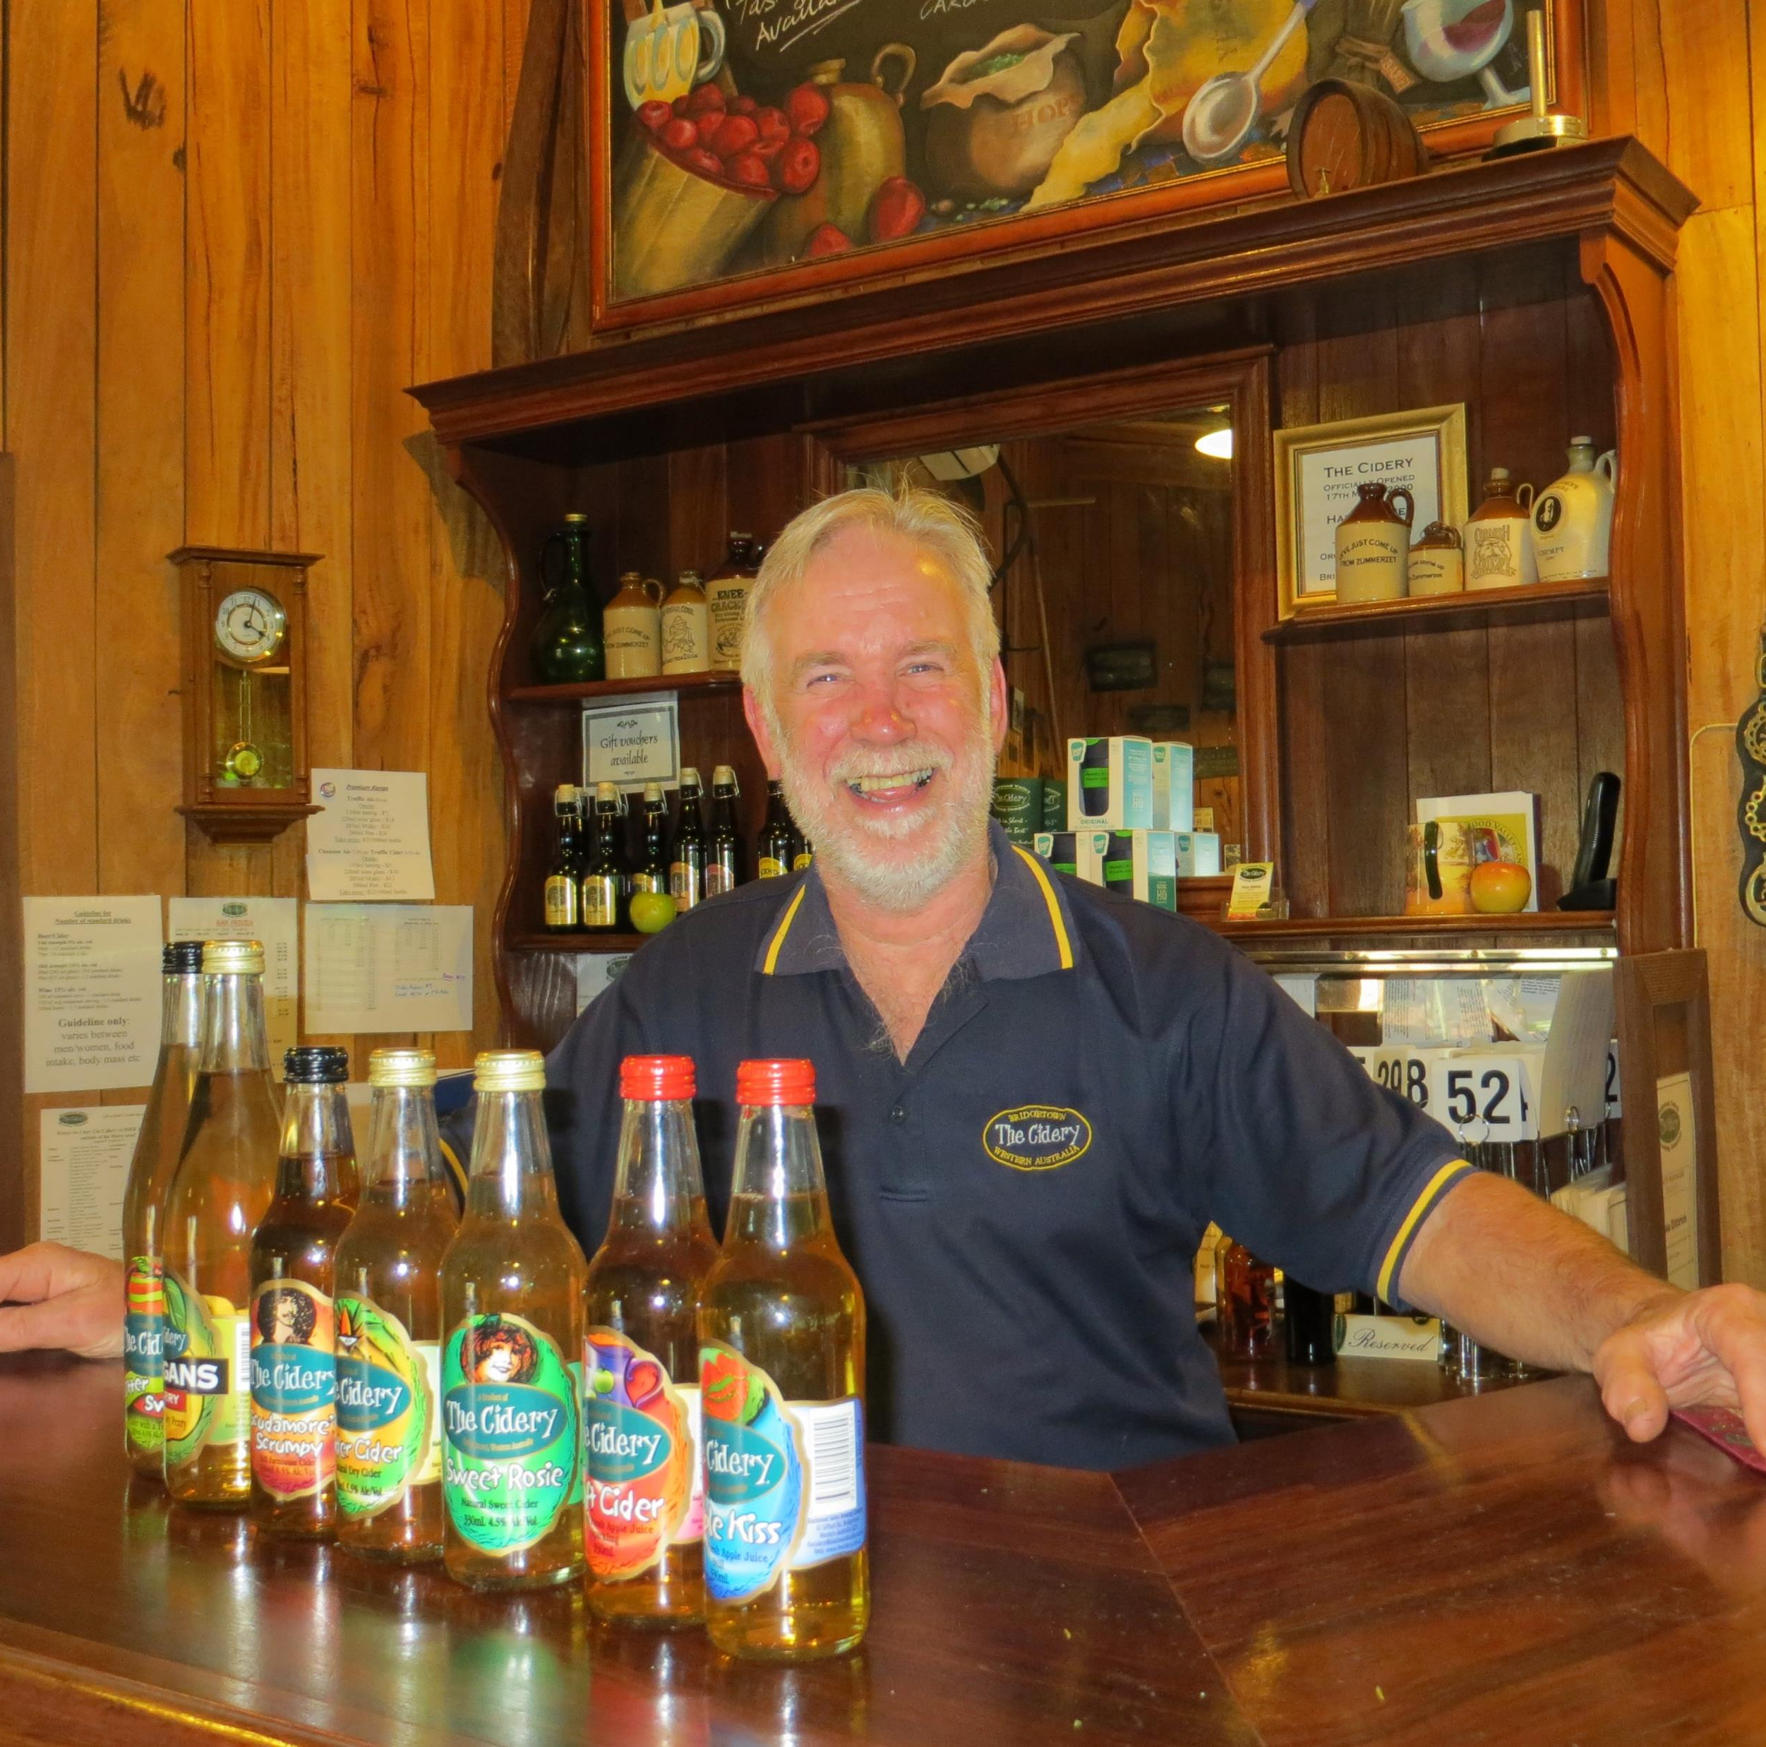
Tourism and Bridgetown
The Cidery and Blackwood Brewing company was instrumental in putting Bridgetown back on the tourist map.

Slide 8
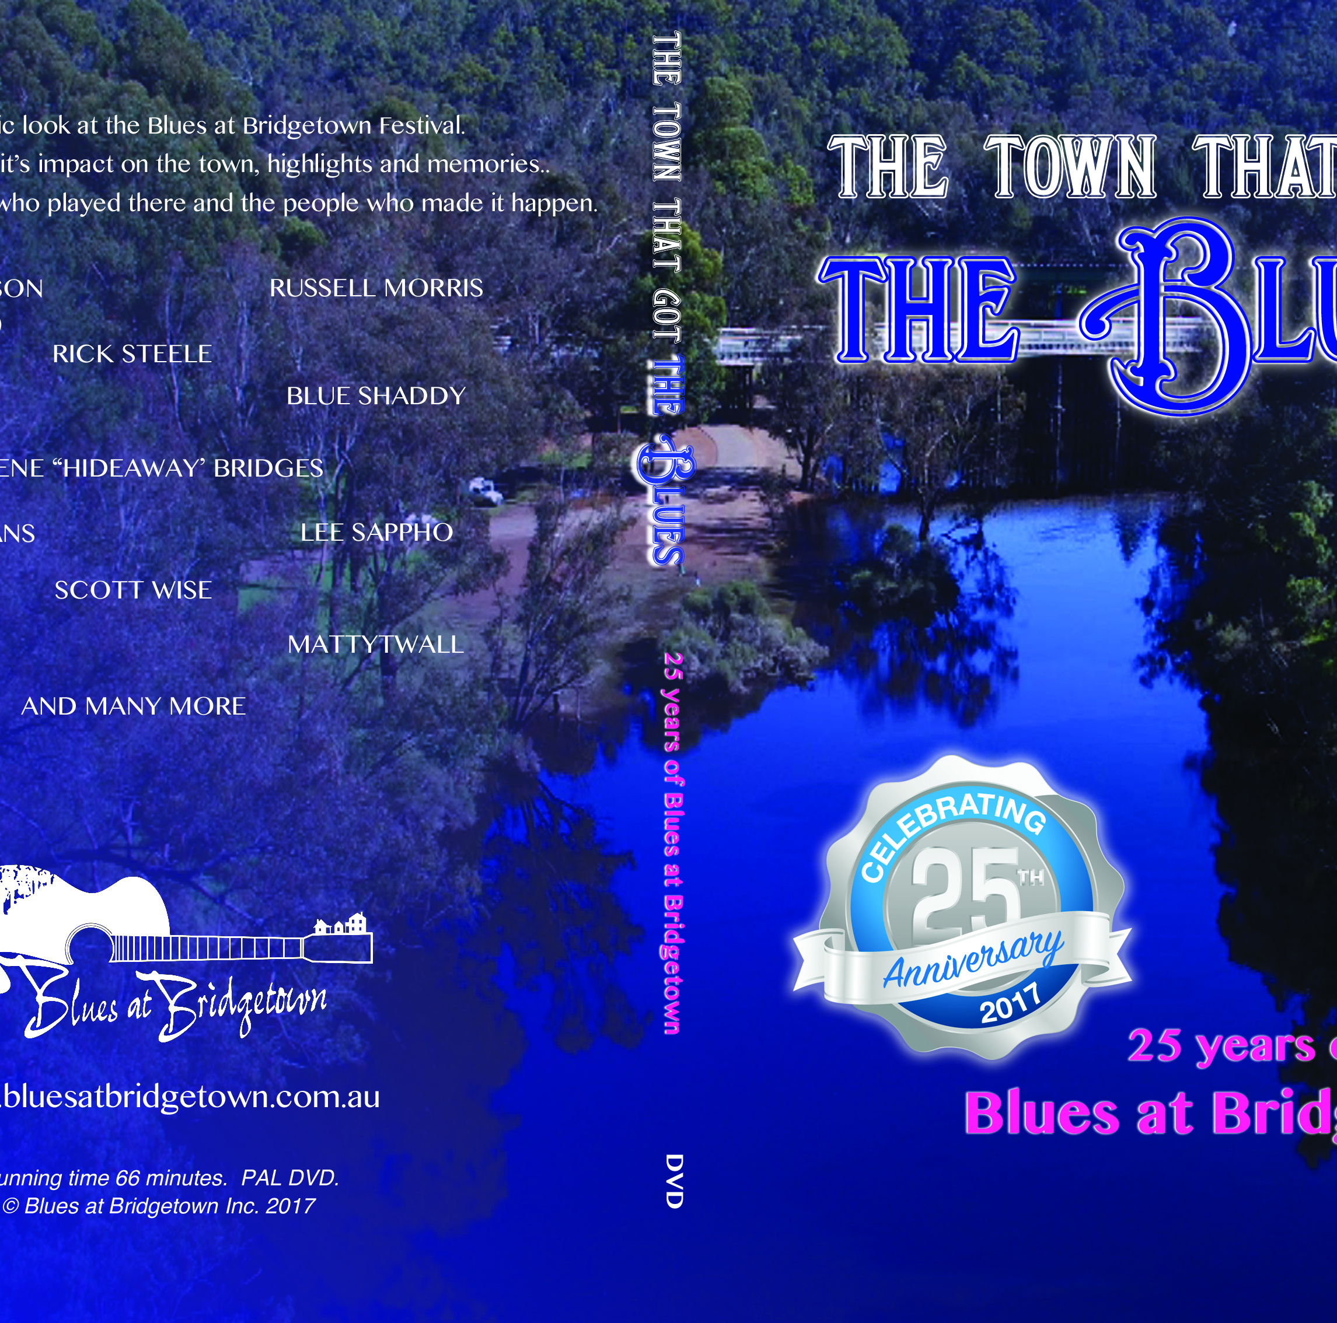
Tourism and Bridgetown
Creative ideas came out of the woodwork including the Blues at Bridgetown, the Rotary Tour of the Blackwood, the Blackwood Marathon to name a few.
It all helped boost Bridgetown as a tourism destination.
But…

Slide 9
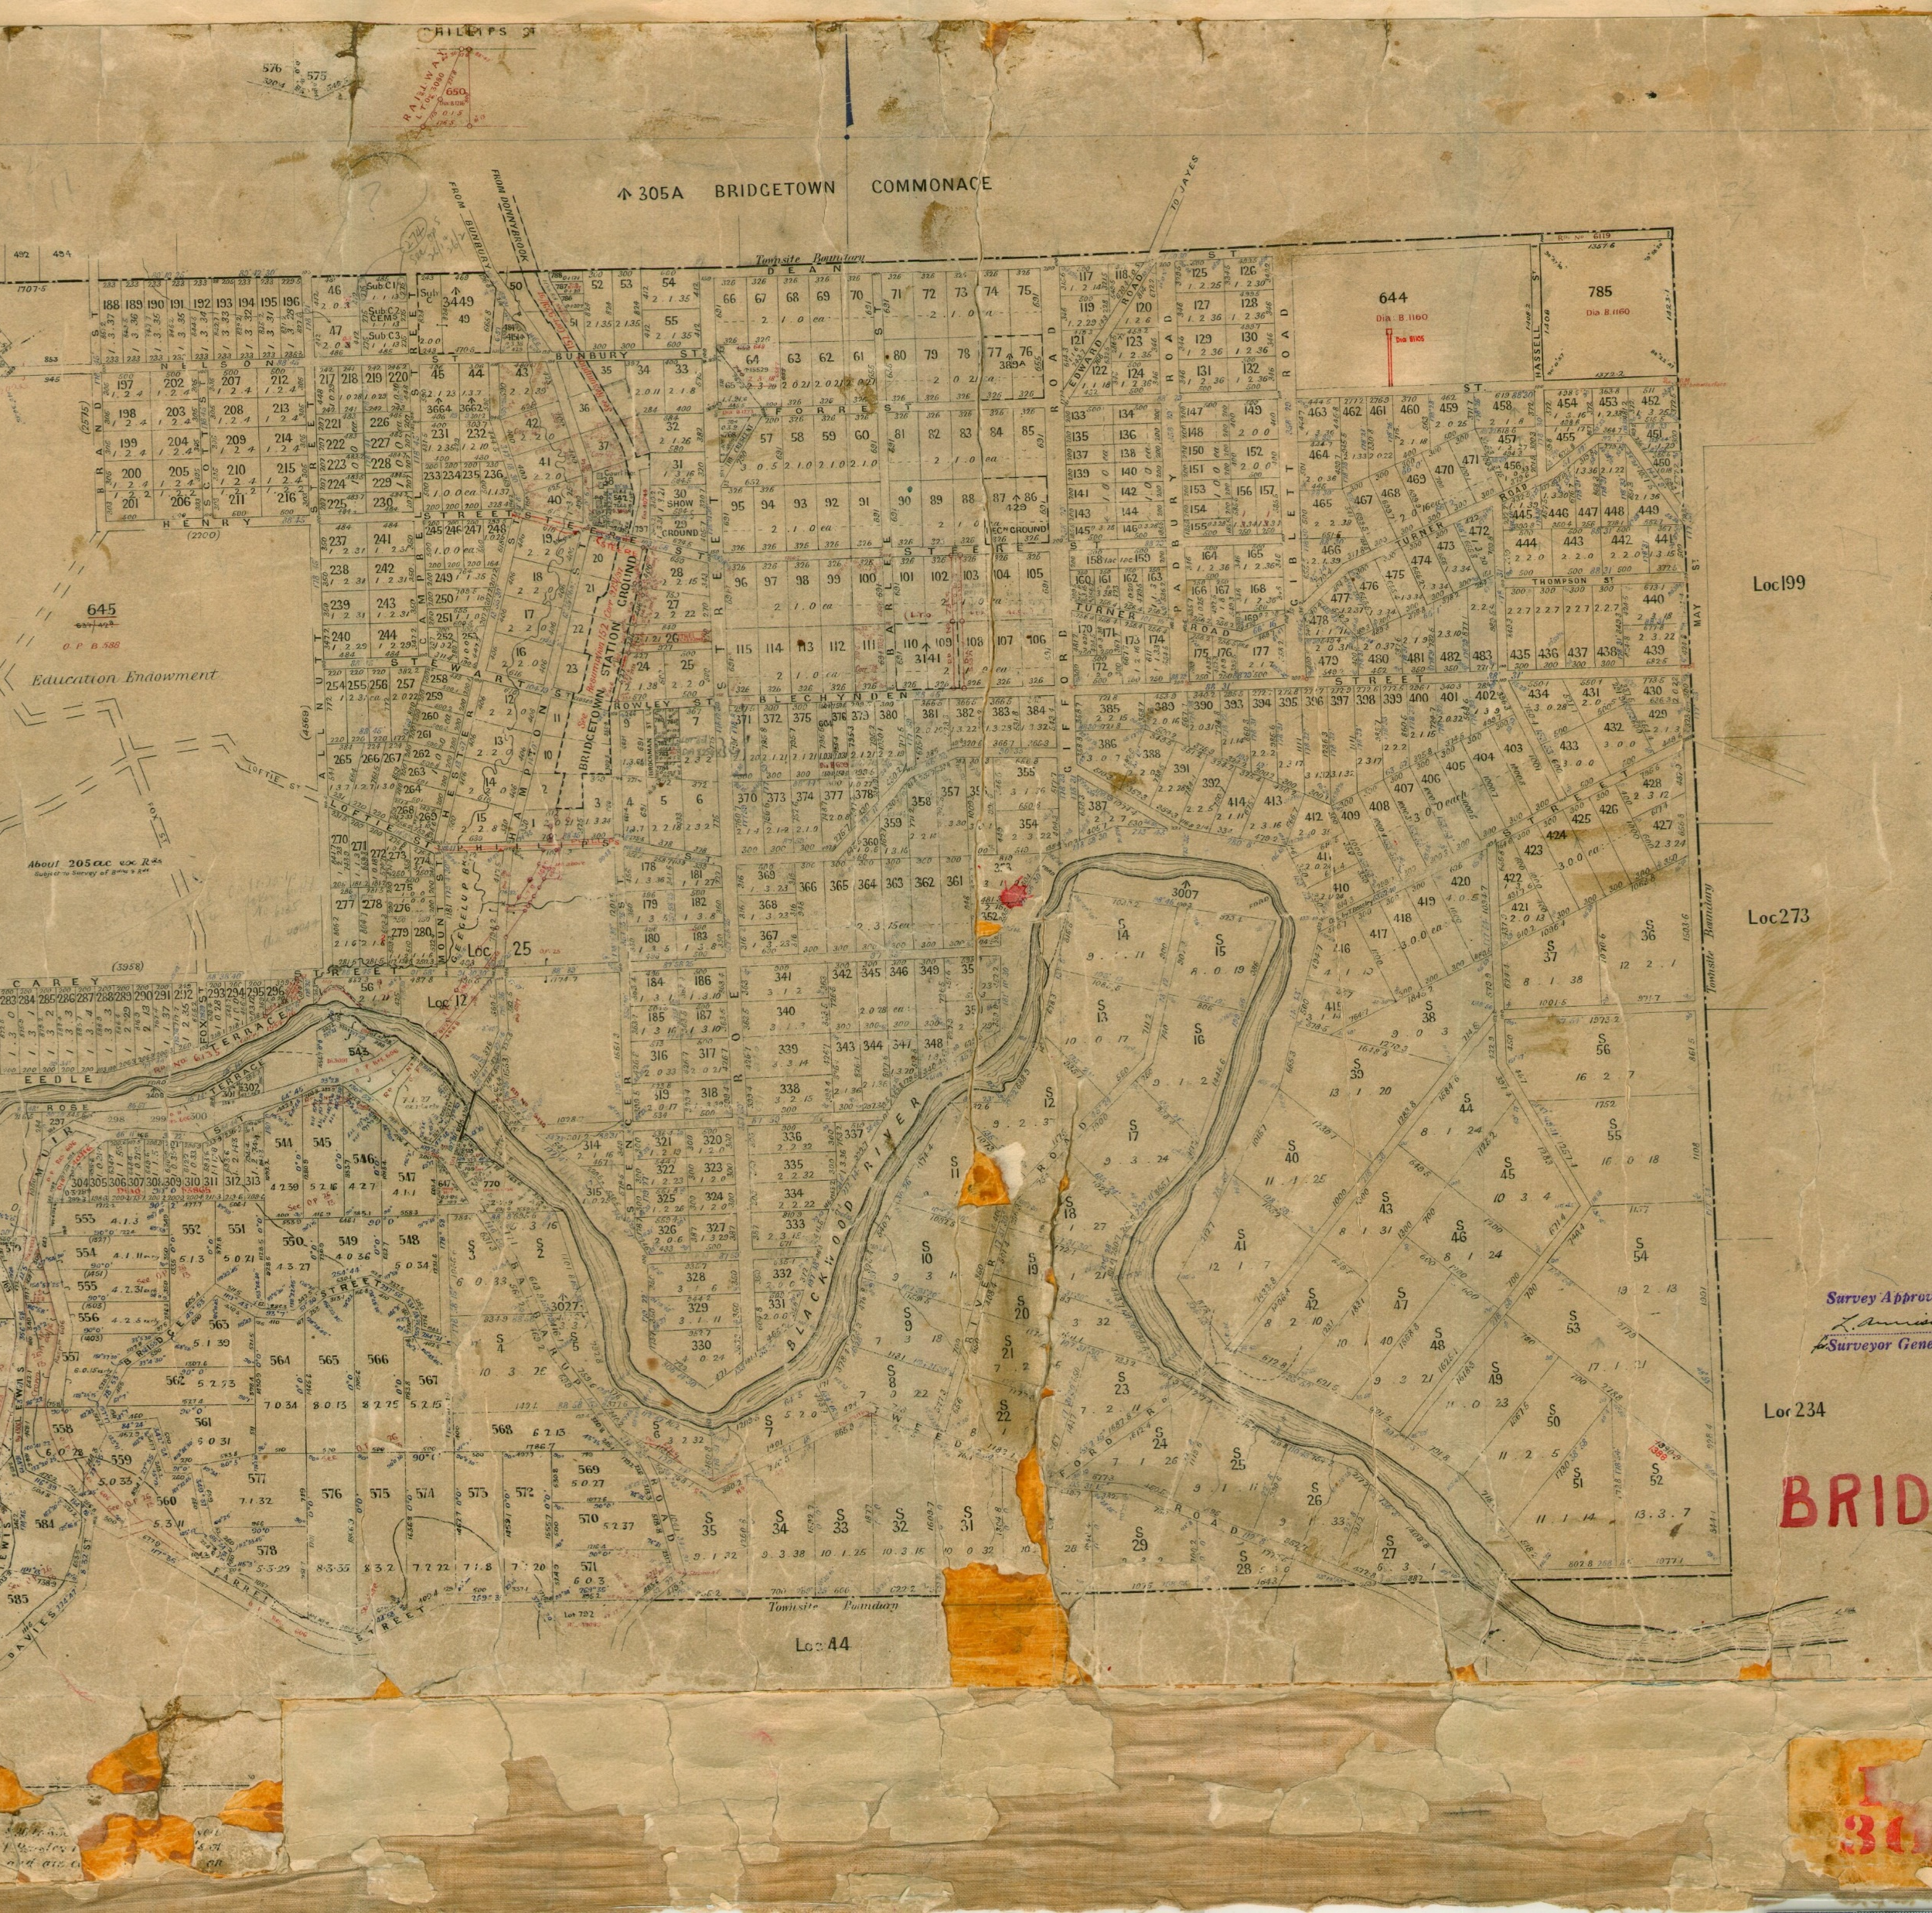
Tourism and Bridgetown
… none of these ideas used the inherent history of the town and certainly not the Indigenous history.
The history of the country, its people (the Pibulmun and Wadandi), the white settlers – all missing from the narrative.

Slide 10
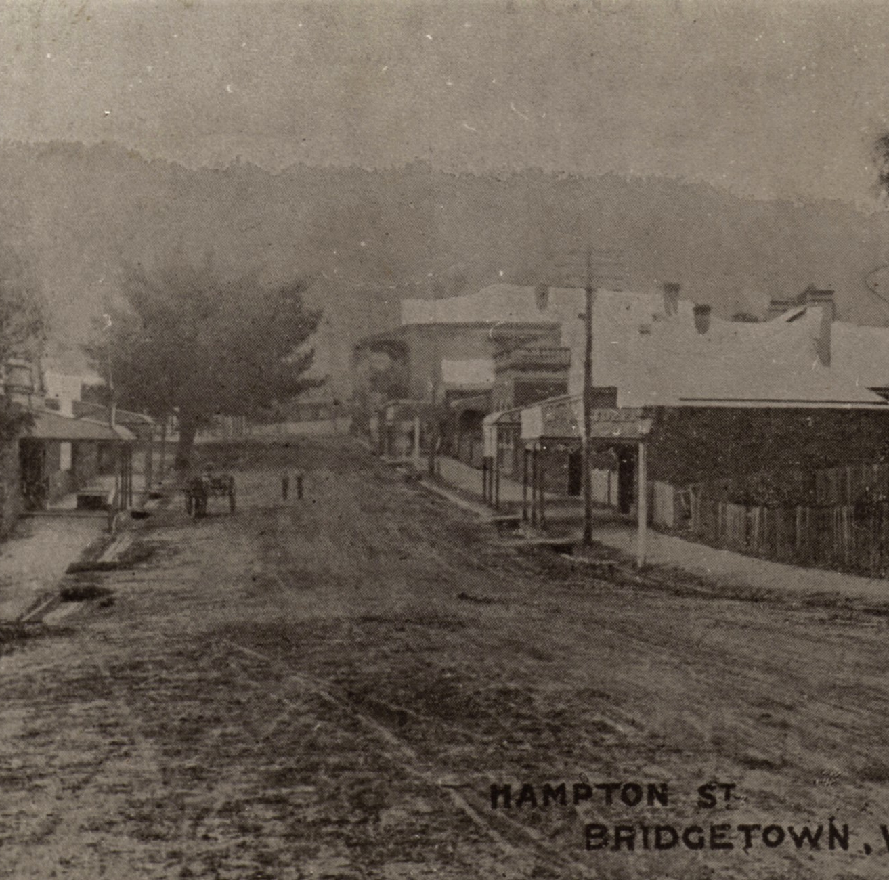
Tourism and Bridgetown
In 2017, it was clear to me that the town had much history to share and that the Historical Society could bring history to the people instead of waiting for them to come to us.
Ref: BHS 95-281 Hampton St. looking north

Slide 11
Tourism and Bridgetown
Our first foray into heritage tourism came in July 2017.
The Bridgetown Ghost Walk was born. We brought to life people from the past and told their stories.
Ref: BHS 95-281 Hampton St. looking north

Slide 12
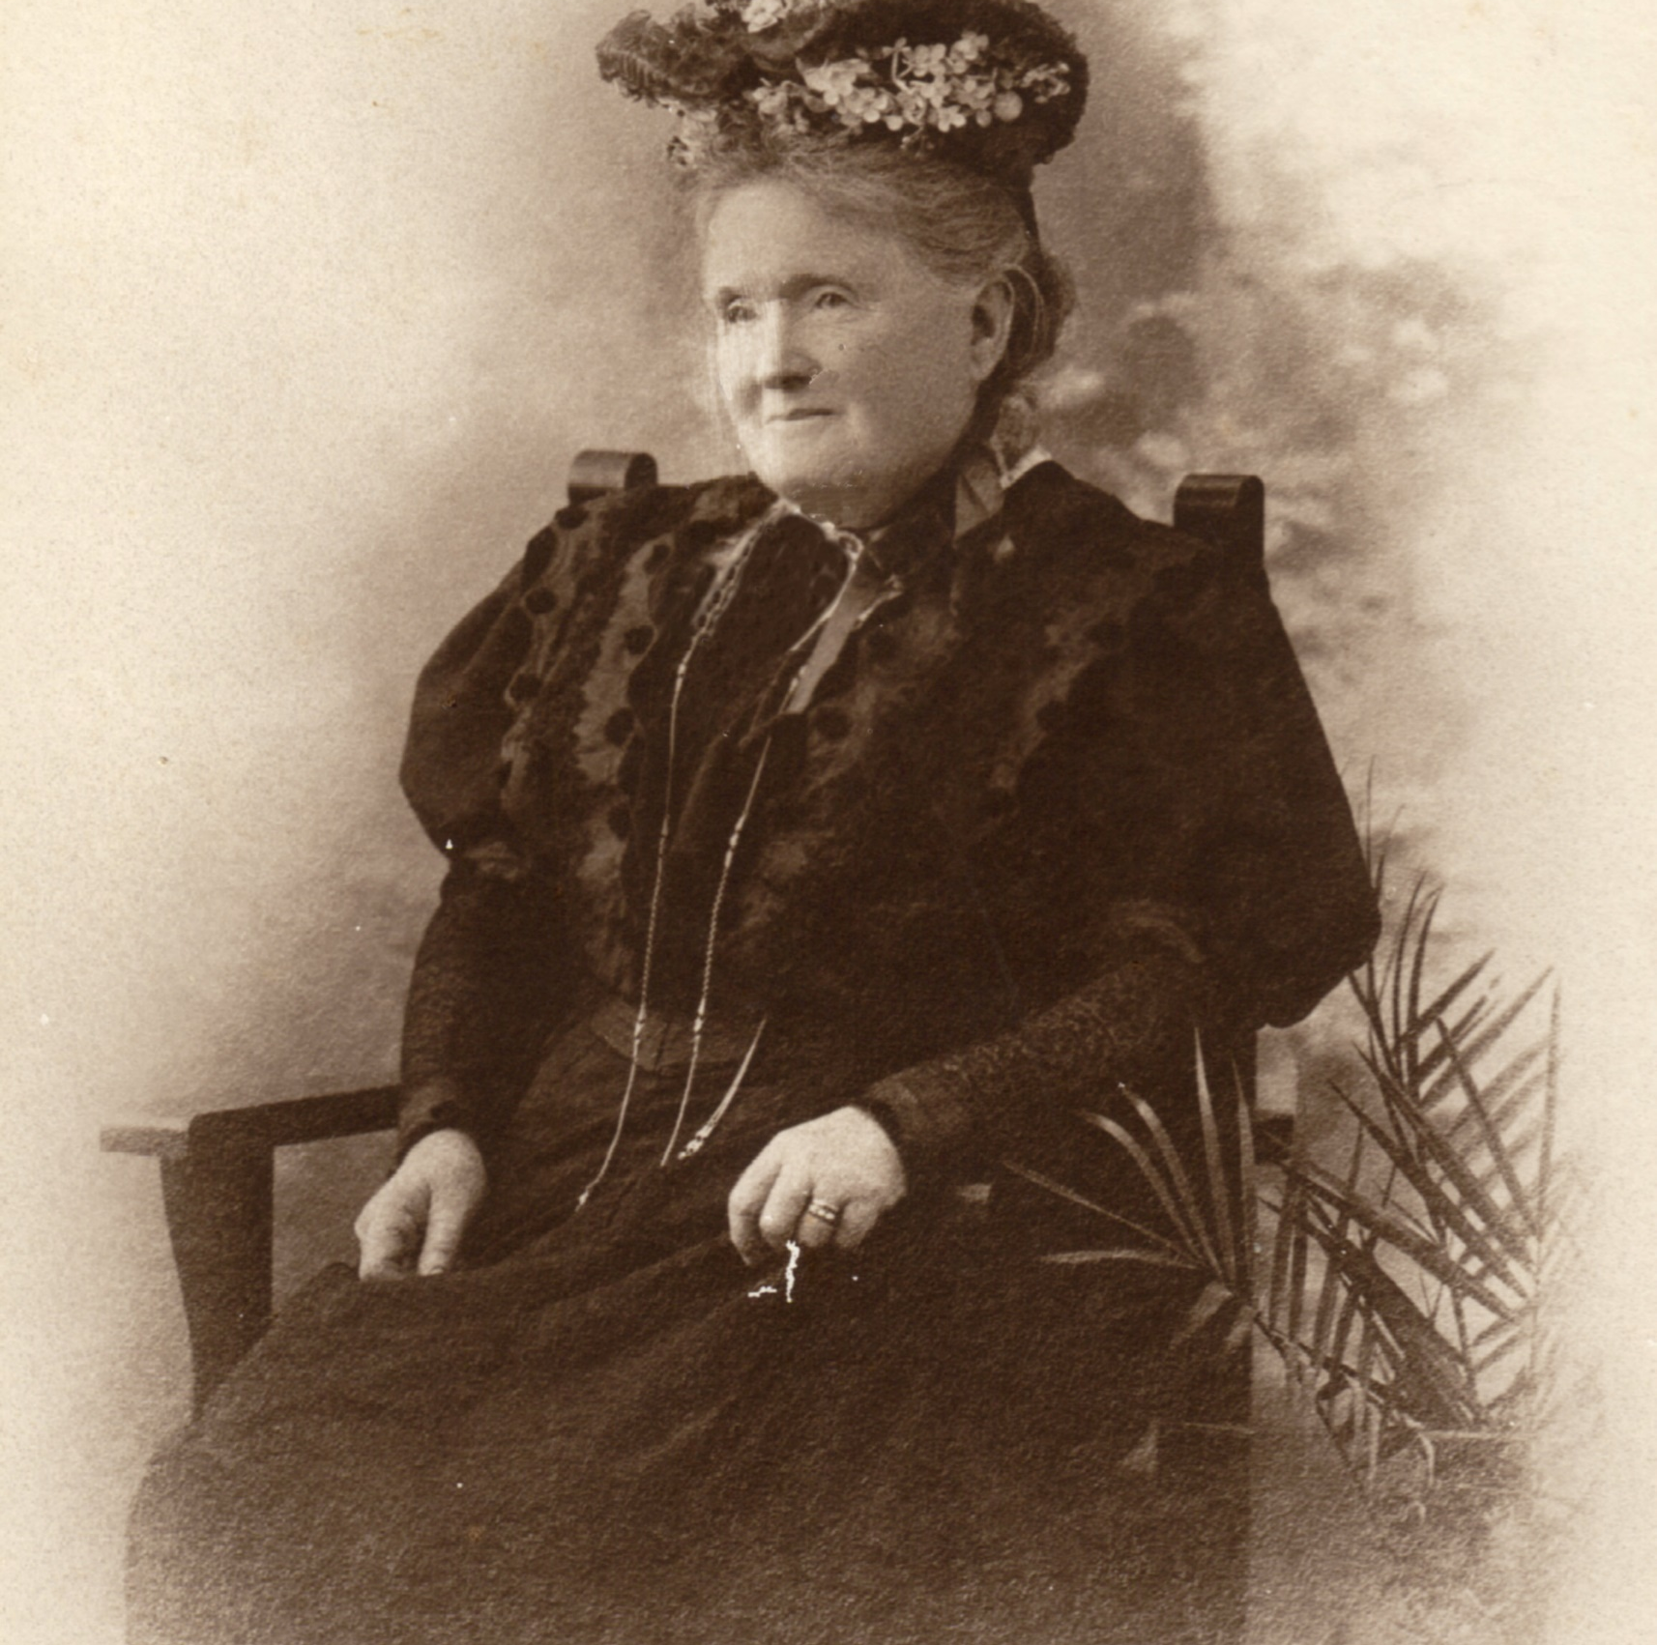
Tourism and Bridgetown
Taking history to a town where there are still direct descendants of the first white settlers (1858) is no easy task.
BHS exposed themselves but chose to bring back to life those people who had made significant contributions.
Ref: BHS 95-217 Kate Allnutt

Slide 13
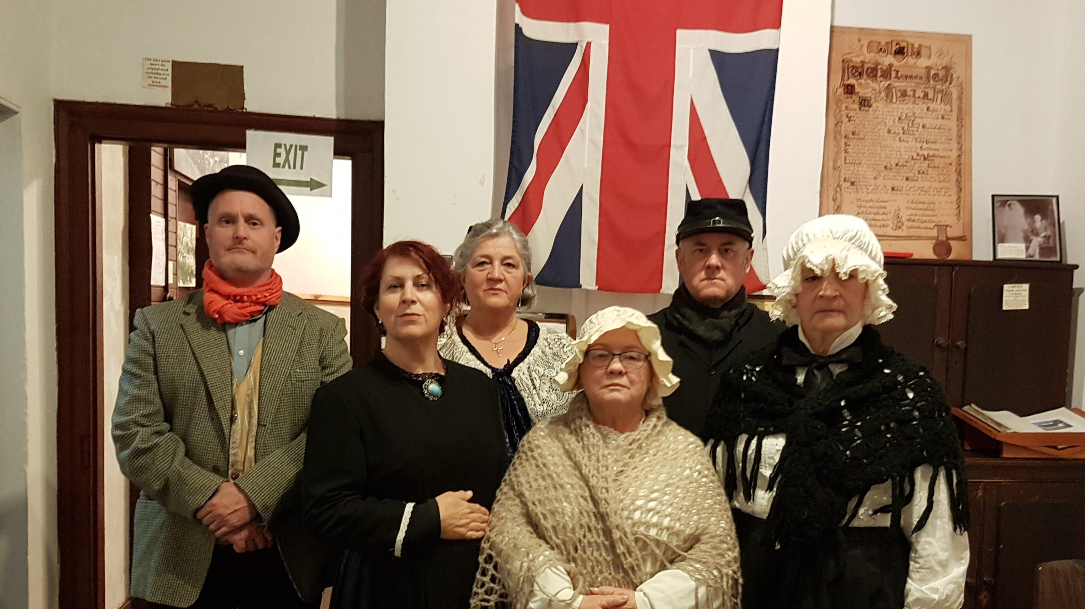
Our‘ghosts’2018

Slide 14
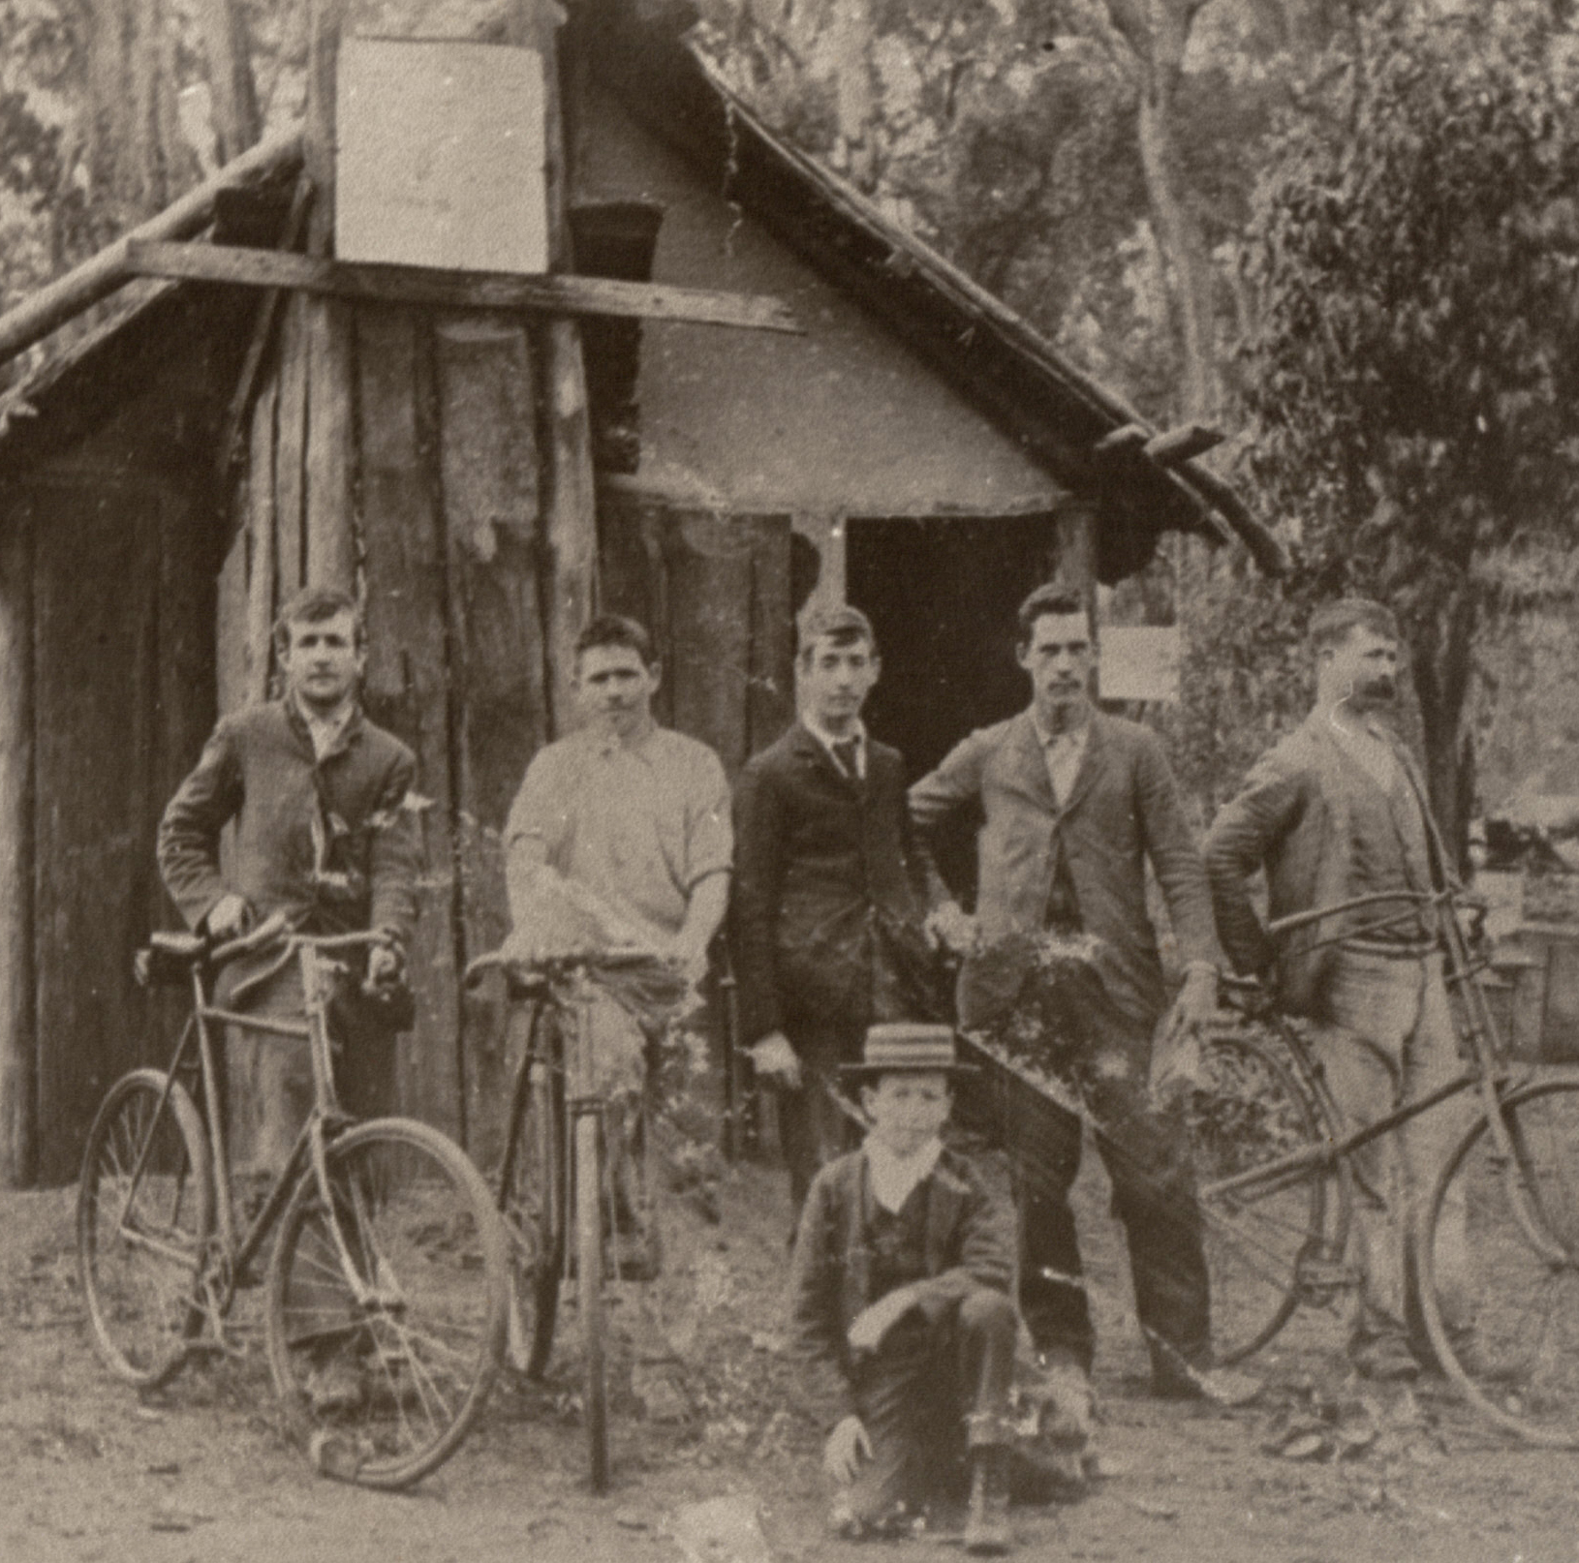
Tourism and Bridgetown
We were hopeful of maybe 20 people.
55 turned up the first night and 80 the second night.
It was a nightmare!
Ref: BHS 95-294 Doust brothers & friends

Slide 15
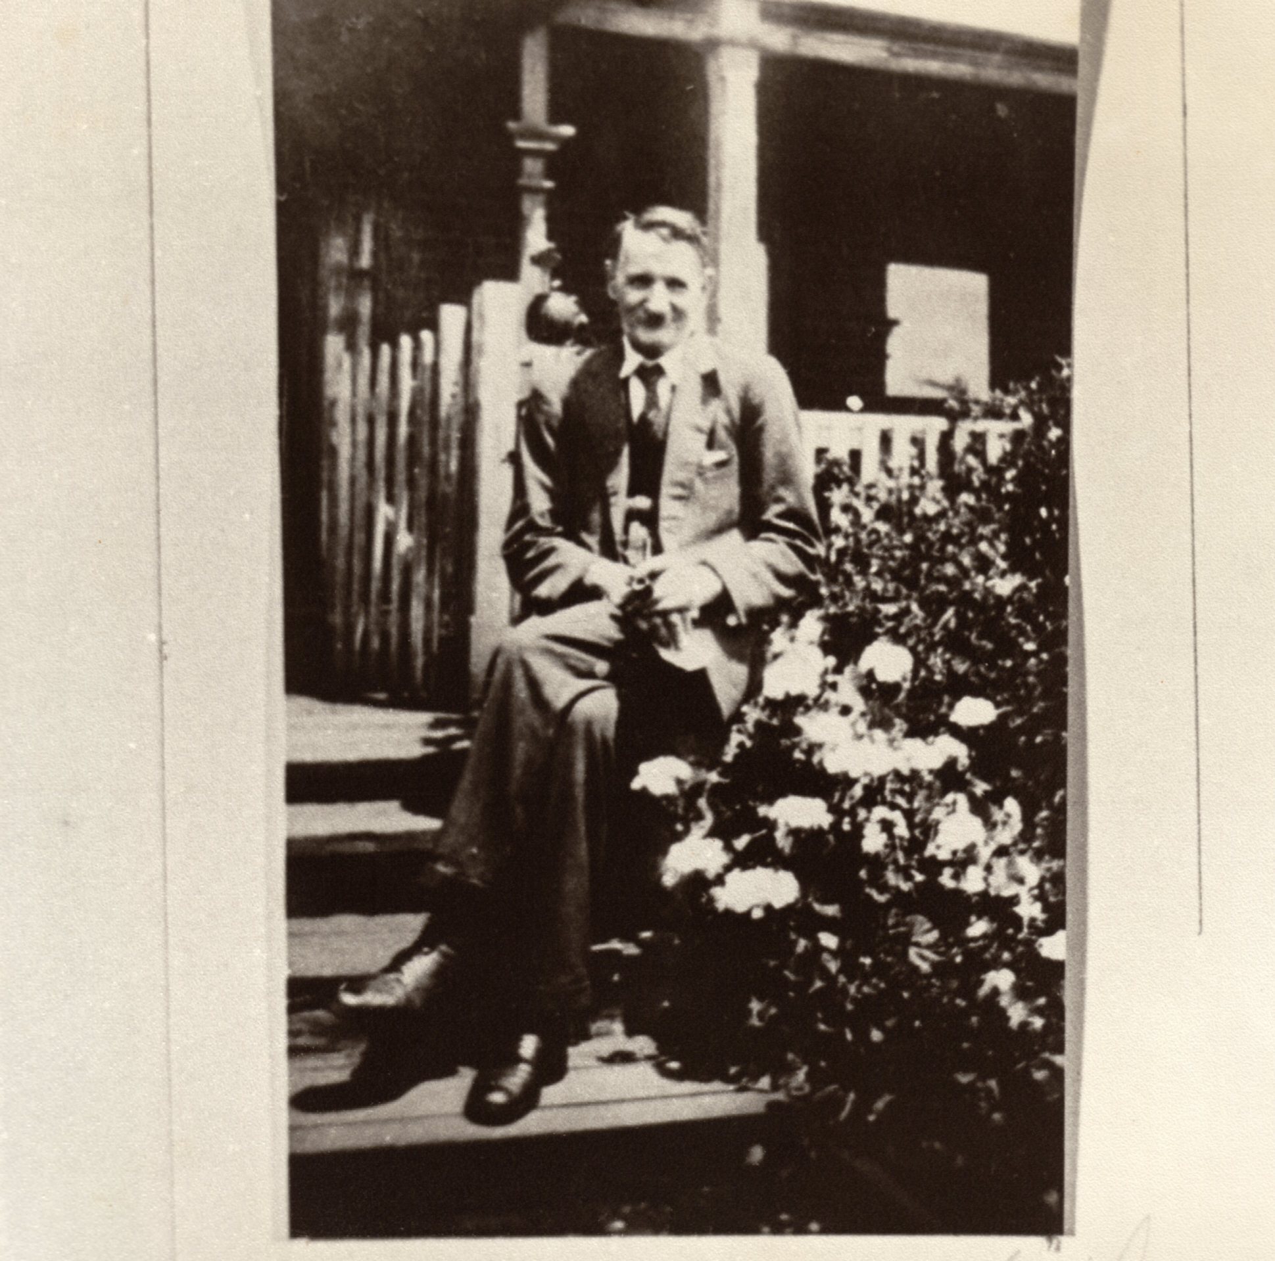
Tourism and Bridgetown
From that auspicious beginning we now conduct ghost walks, private tours and school groups into the history of Bridgetown, and it is a major money spinner for BHS.
Last winter (because of COVID) we had great success with cemetery walks instead of ghost walks.
Ref: BHS 95-20 Major Whittell, founder of an historical society in Bridgetown c.1947

Slide 16
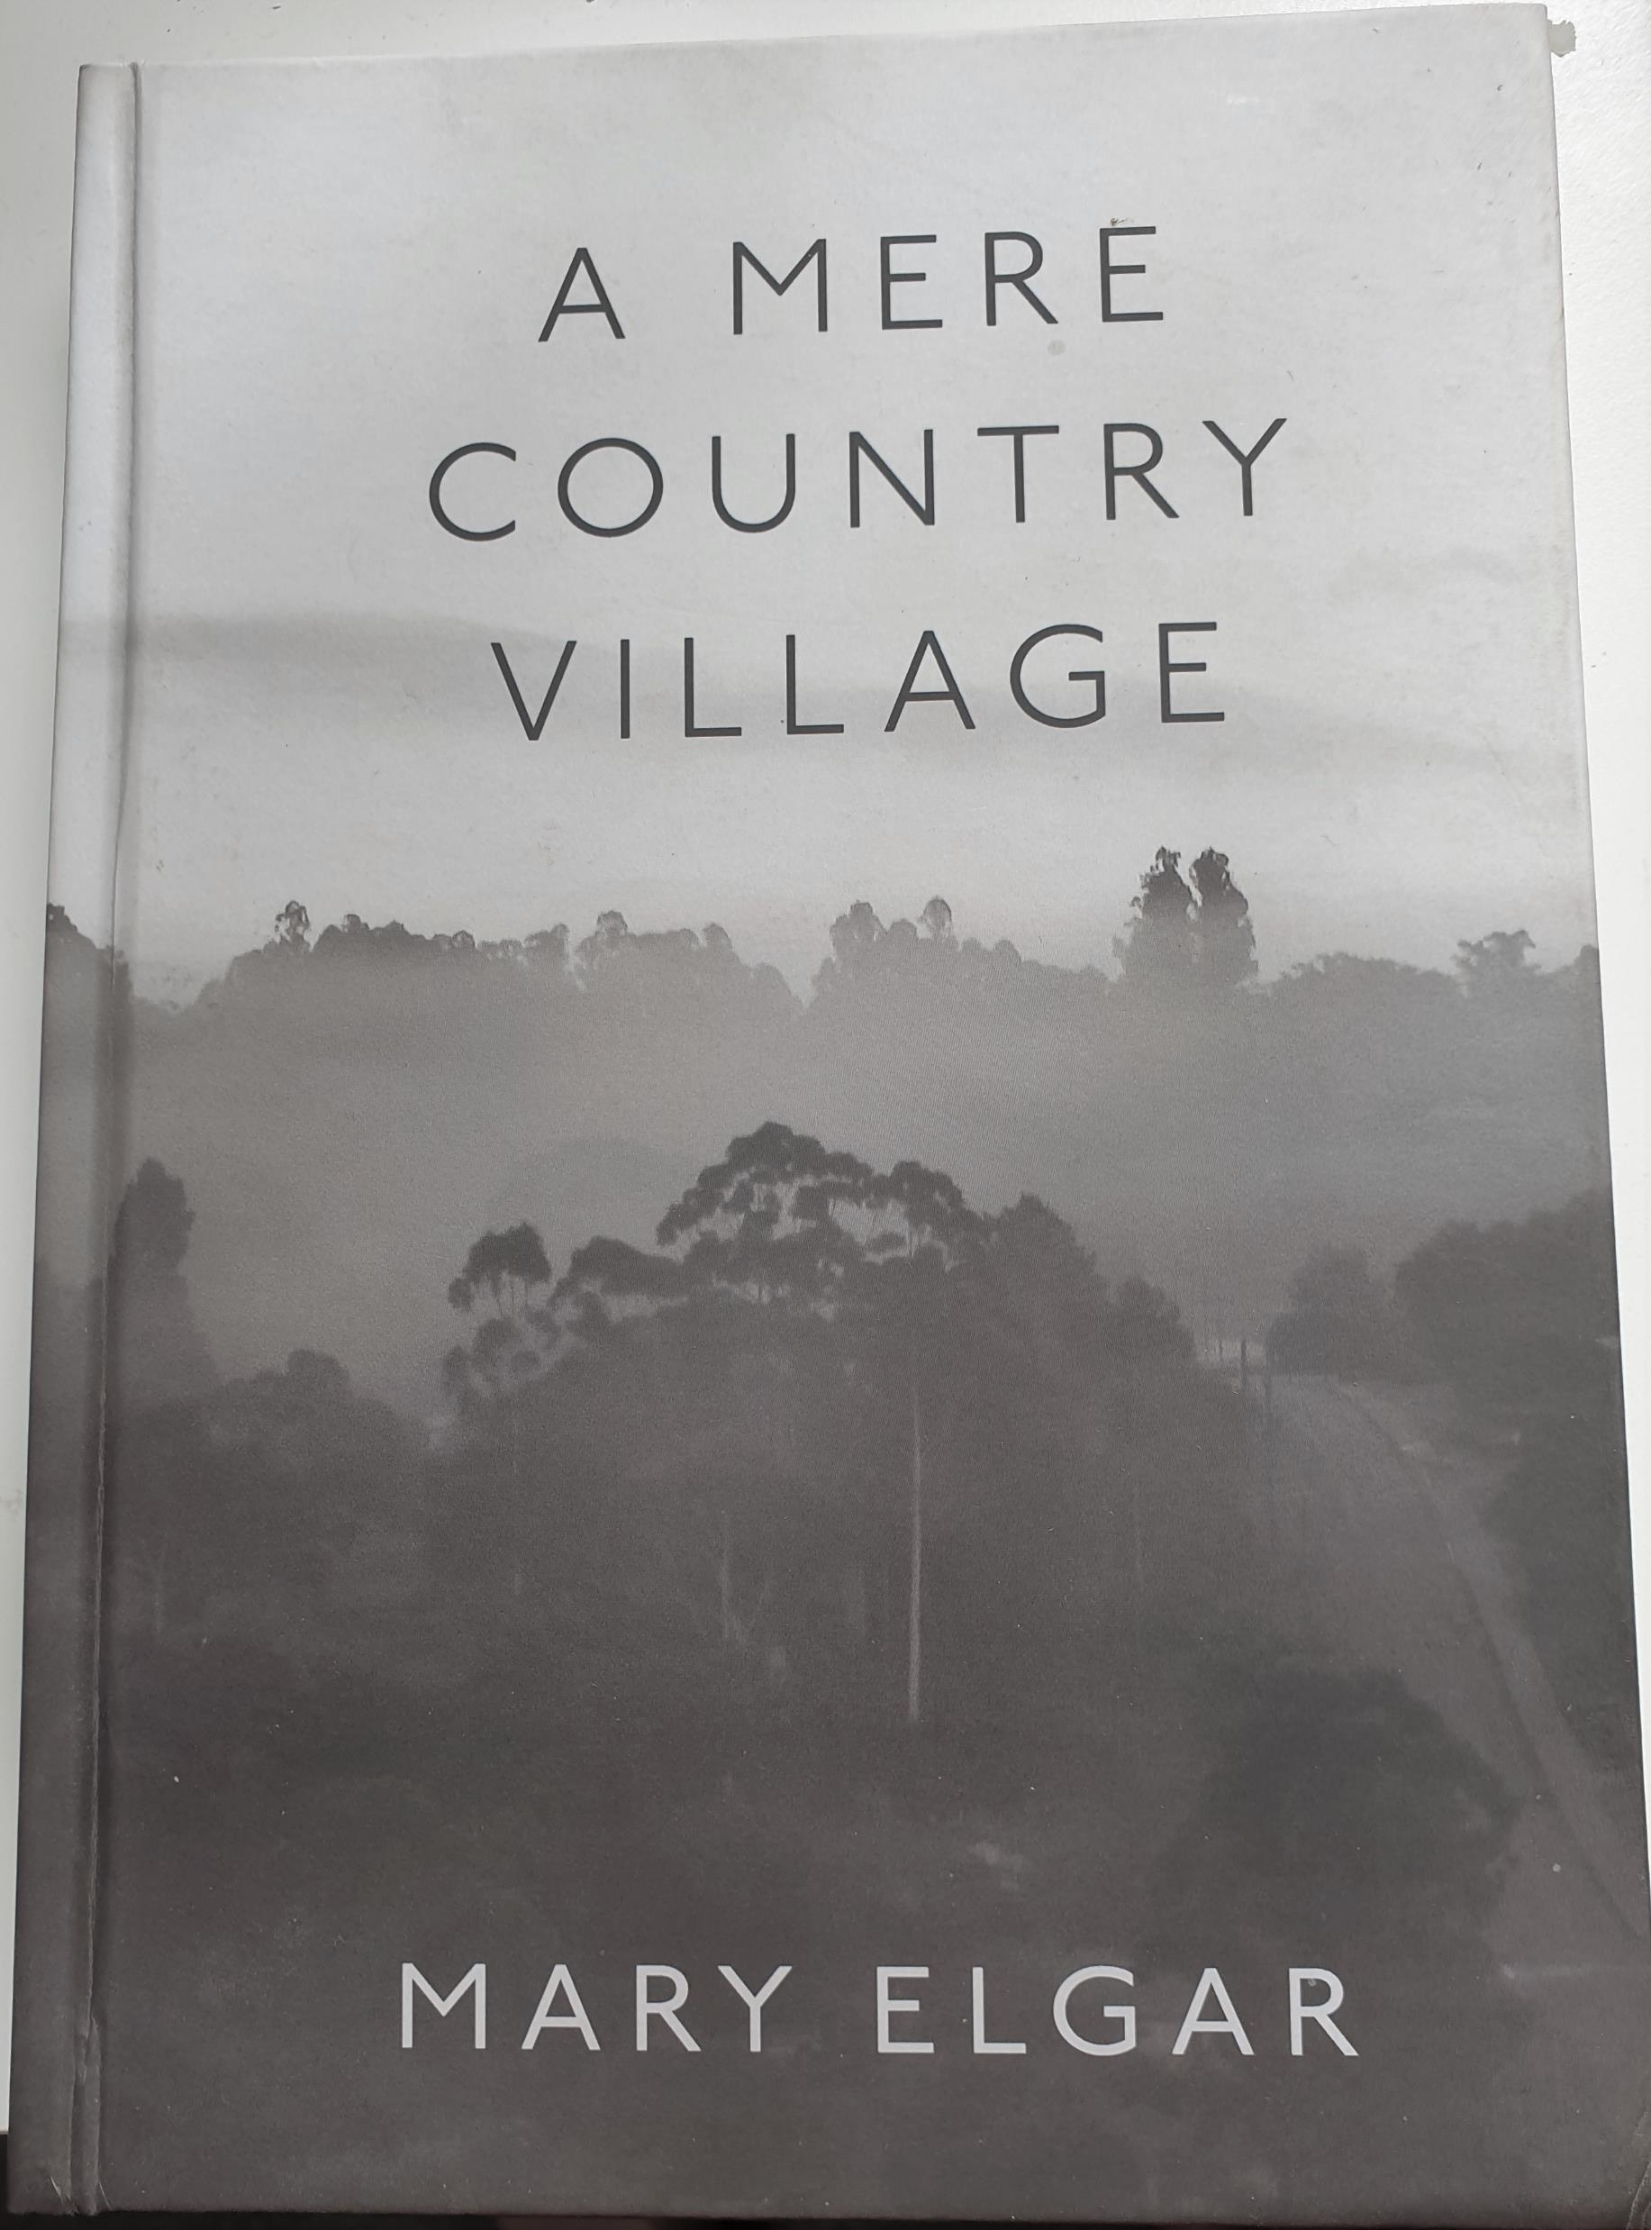
Tourism and Bridgetown
To further enhance the history of the town, a book was written using oral histories from past and present residents.
The book focused on how a community was formed and maintained.
We have sold 500 copies in 2 years. All proceeds go to BHS, who owns copyright.
It all helps take history to the people, even those who think they know it all about their town!

Slide 17
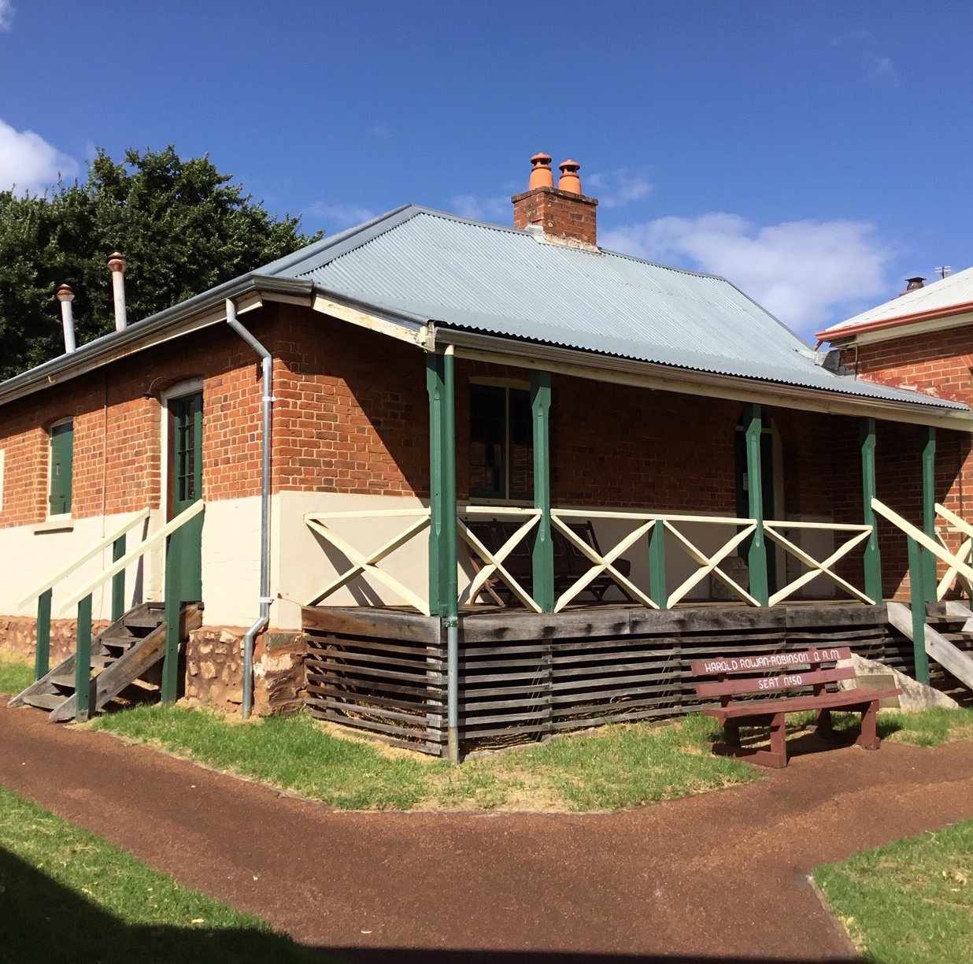
Tourism and Bridgetown
Integral to heritage tourism is the rural museum. But many are simply repositories for ‘old’ stuff. Ours was too.
But through hard work in 2019, the Bridgetown Police Station Museum become a vibrant, contemporary space, telling a clear story through the building, with new interpretive panels, & soon an audio system & visual monitor, a Braille brochure with tactile maps and Easy Read cards.
The history will be accessible to all visitors.
Bridgetown Police Station Museum 2019

Slide 18
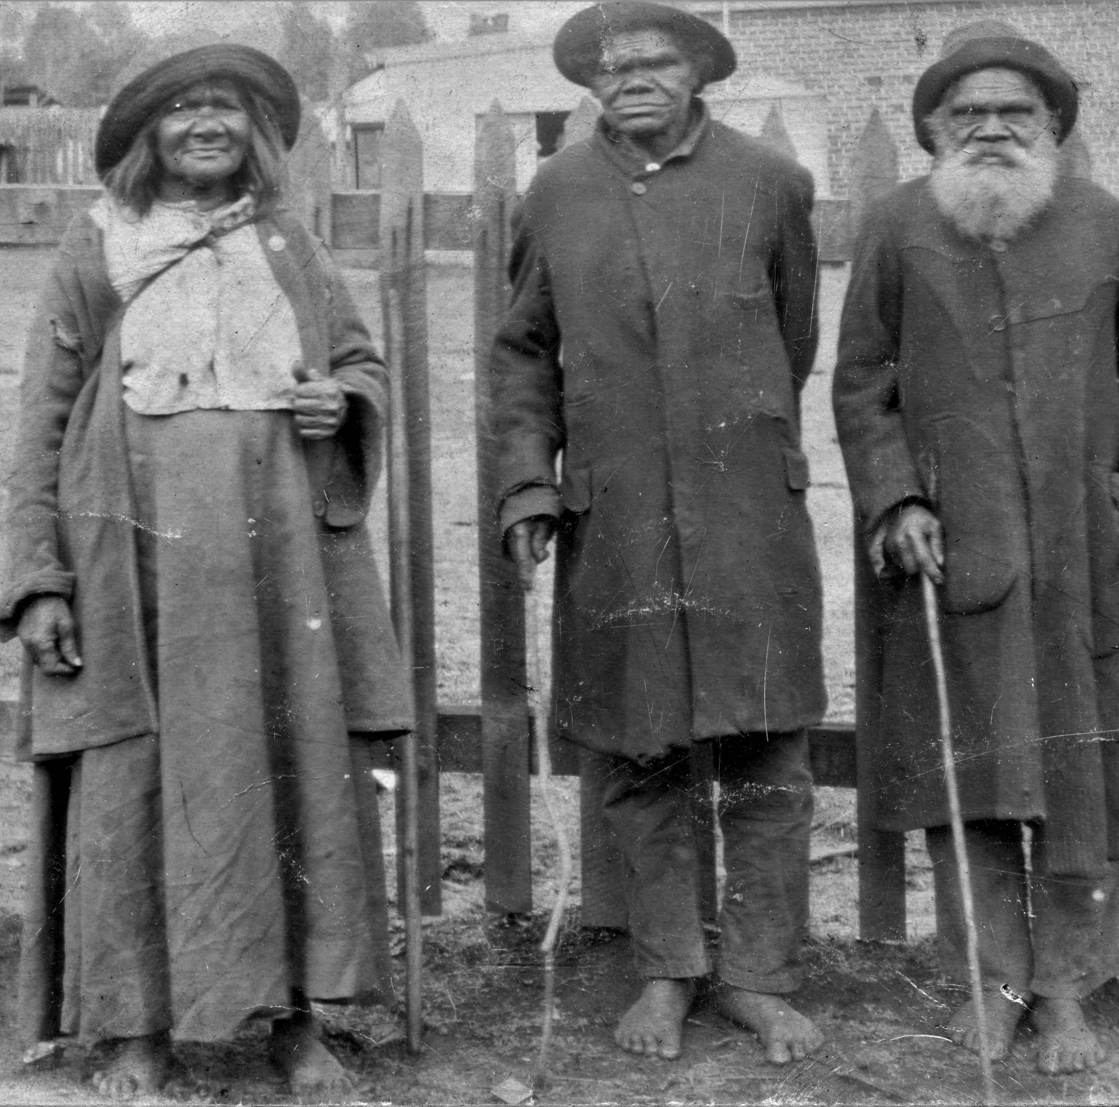
Tourism and Bridgetown
The Museum is also a leader in its field for weaving the dark, Indigenous history into the interpretive panels.
These citizens of Bridgetown, Mary-Anne, Peter and King Billy c.1915, once shunned from the town, are now proudly acknowledged in the Museum – a great granddaughter of King Billy visited last year and was thrilled to see this photo of her family.
Ref: BHS 95-466

Slide 19
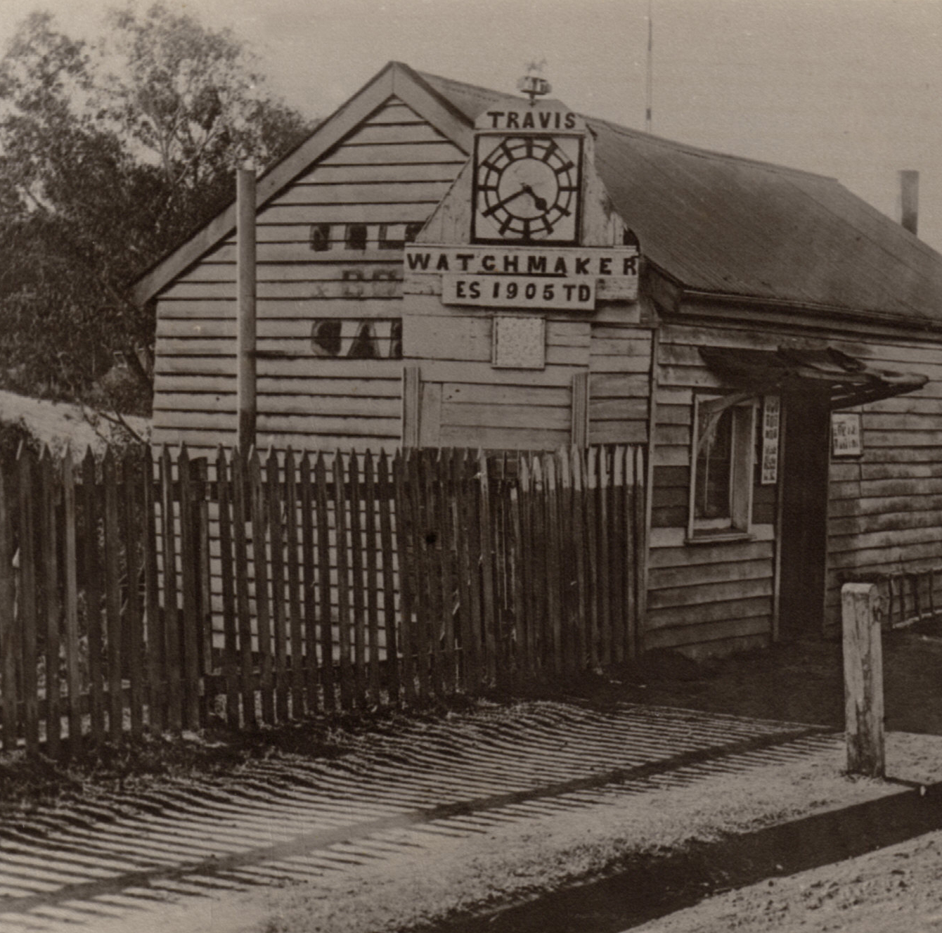
Tourism and Bridgetown
Visitors want to learn about the past, but take them out of their comfort zone, show them the past as it really was. Tell them the truth about white settlement and the effects it had on the Indigenous people.
“If you do not know where you have come from, you will not know where you are or where you are going.”
(courtesy of Terry Pratchett)
Ref: BHS 95-111

Slide 20
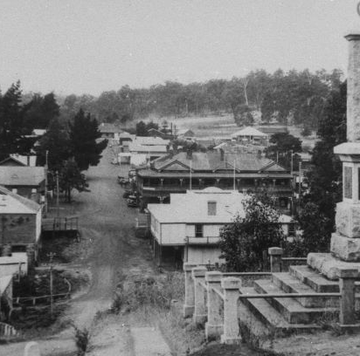
Tourism and Bridgetown
History evolves all the time; it changes and adapts to new discoveries.
By sharing the past, we help move towards the future.
Heritage tourism is at the forefront of this new search for our past.
Bridgetown has embraced it and so should your town.
Ref: BHS 10-355

